Slide 1
Capstone Project : The Battle of Neighborhoods
Leveraging data science to analyze the potential of starting business activities in the most promising neighborhoods of Munich, Germany
Christina Psylla I 09.08.21

Slide 2
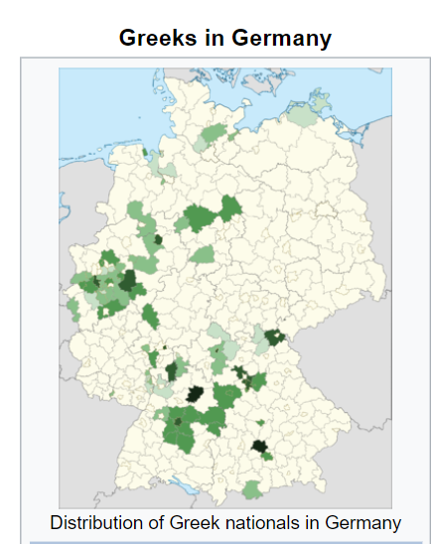
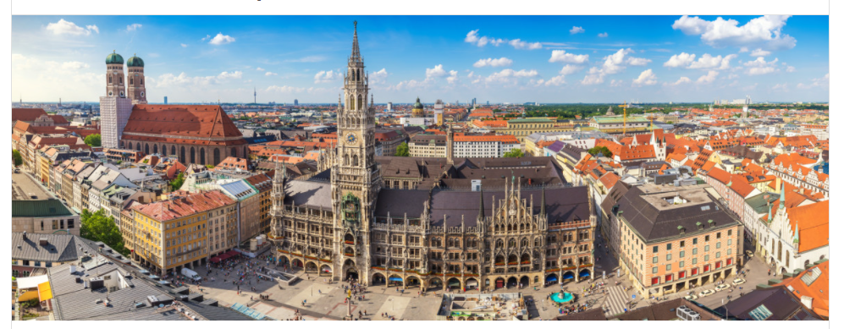
1. Introduction: Business Problem
Munich hosts the majority of Greek people living in Germany, but does not offer a variety in greek restaurants.
Therefore, the few greek tavernas in Munich are always crowded independently of time and day of the week.
This project aims into determining the best neighborhoud to start such a business in Munich city, Germany.

Slide 3
2. Data
Information about the venues in all boroughs of Munich
'https://www.muenchen.de/leben/service/postleitzahlen.html'
Geocoder Python packag https://geocoder.readthedocs.io/index.html
Average price per m² of the apartments in Munich
https://de.statista.com/statistik/daten/studie/260438/umfrage/mietpreise-in-muenchen-nachbezirken/

Slide 4
3. Methodology
Read the postal codes of each neighborhood into a dataframe
Utilize folium map and Munich's geographical coordinates in order to visualize the districts of Munich
Analyze with Foursquare API the venues and venues' categories and we visualize their distribution on the map with color code
Perform a clustering and exploratory analysis to obtain information about the rent price per square meter and the number of venues

Slide 5
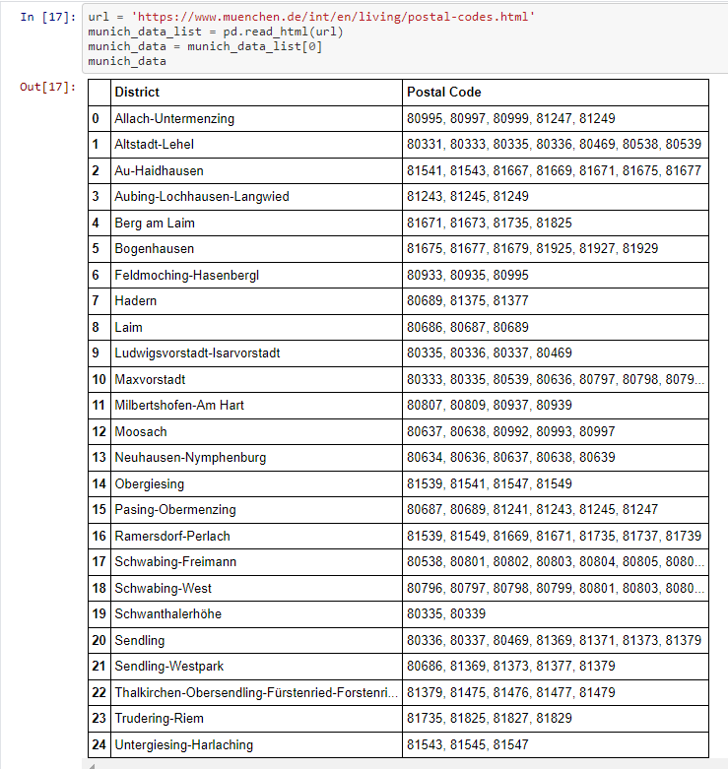
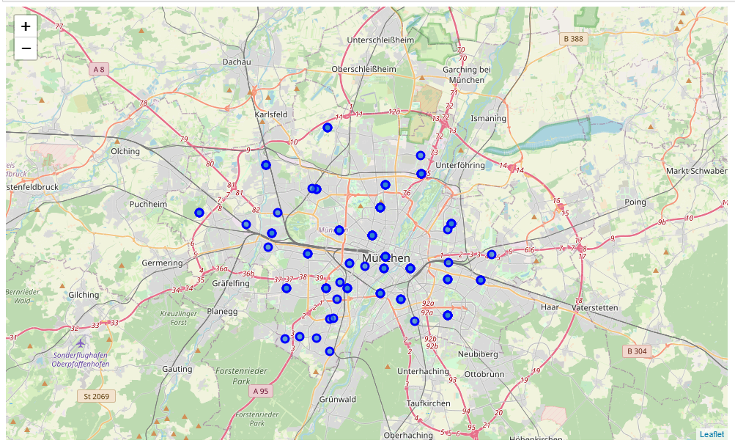
4. Analysis
With webscraping we create the dataframe containing postal codes and districts of Munich
and we visualize them using folium library

Slide 6
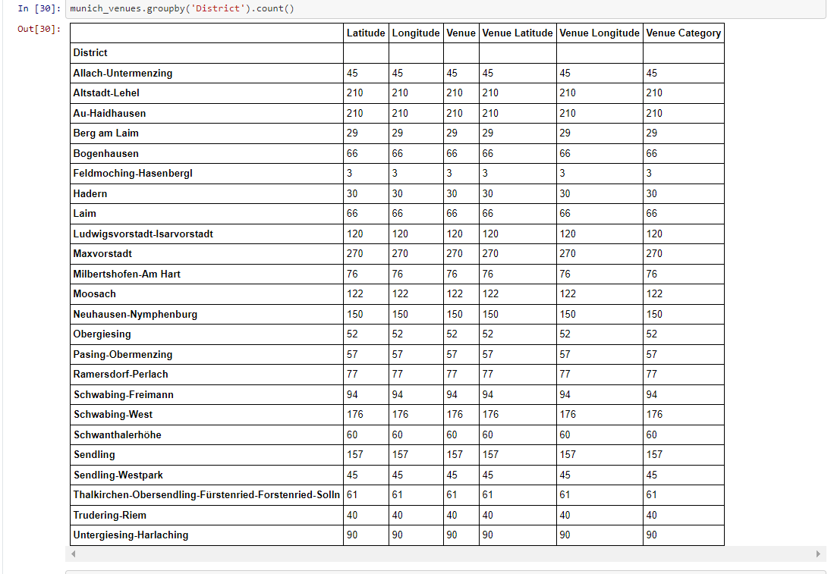
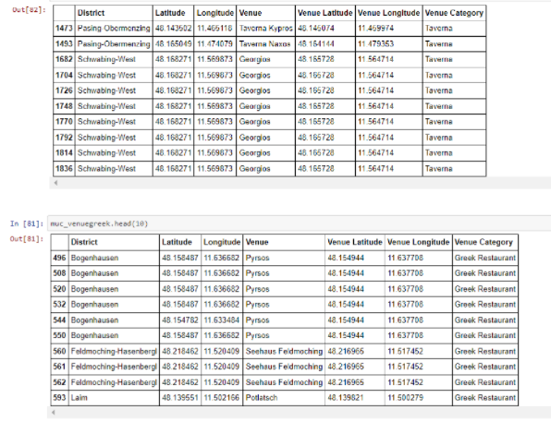
4. Analysis
We explore the nearby in each borough venues with the Foursquare API and we create the Munich venues dataframe for the venues of interest (greek restaurants and greek tavernas)

Slide 7
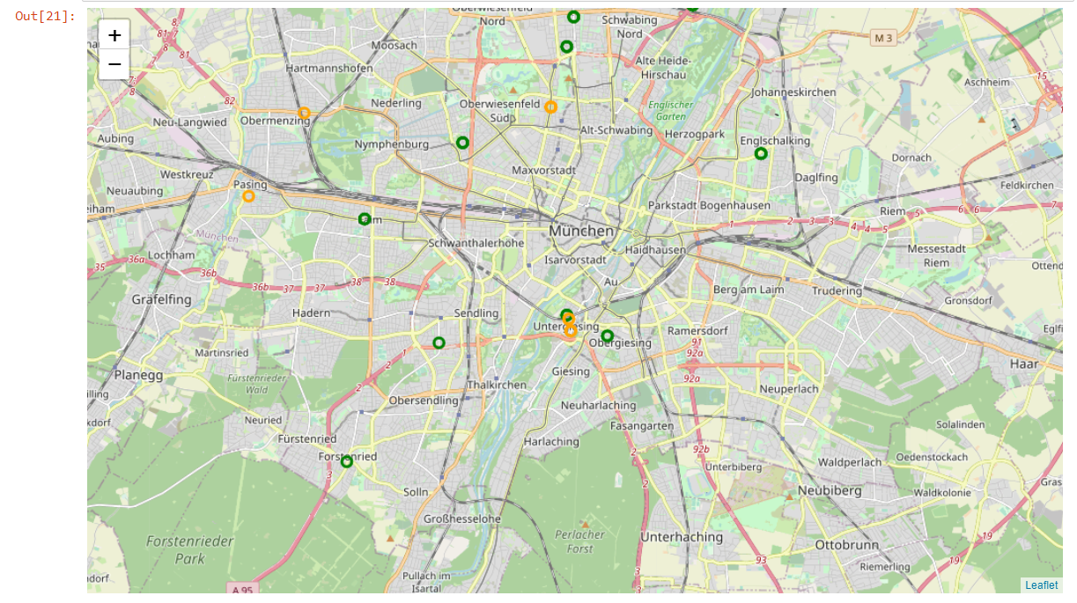
4. Analysis
We visualize the venues of interest per district (green for greek restaurants and yellow for greek tavernas)

Slide 8
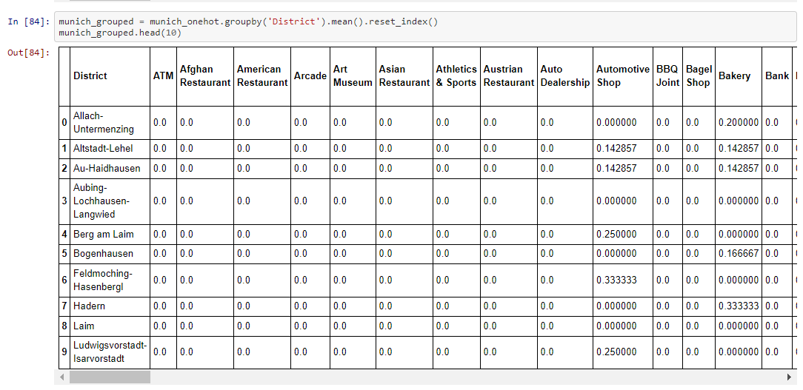
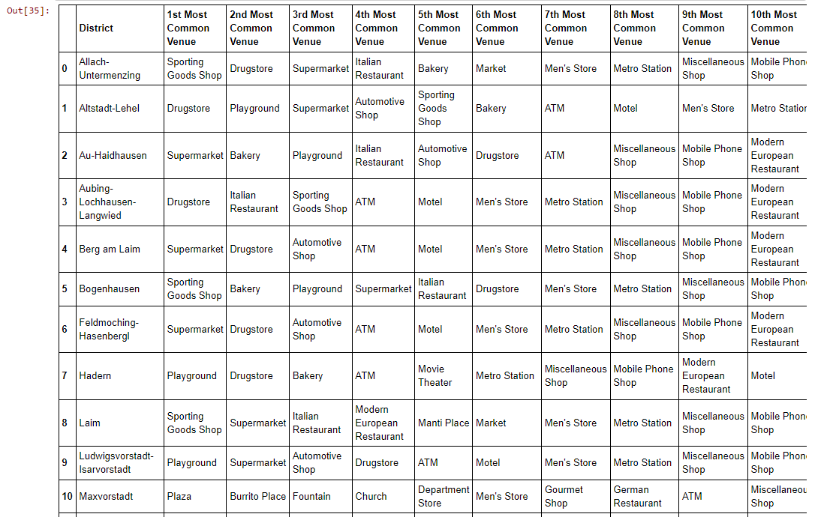
4. Analysis
We create a dataframe with the most common venues per borough

Slide 9
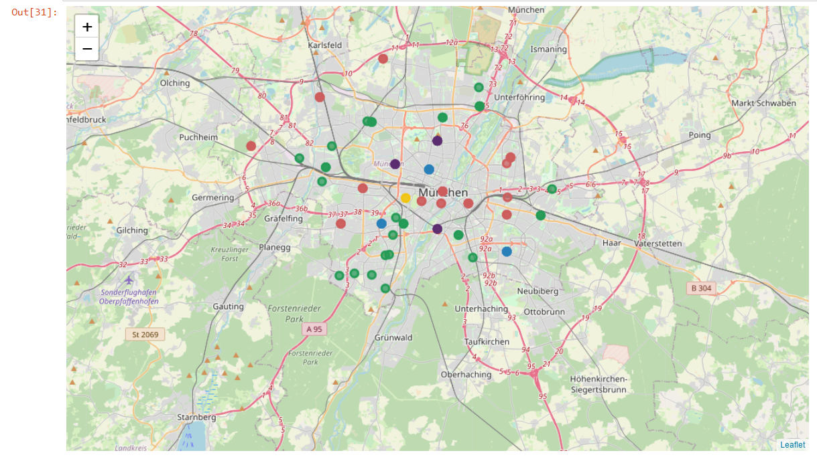
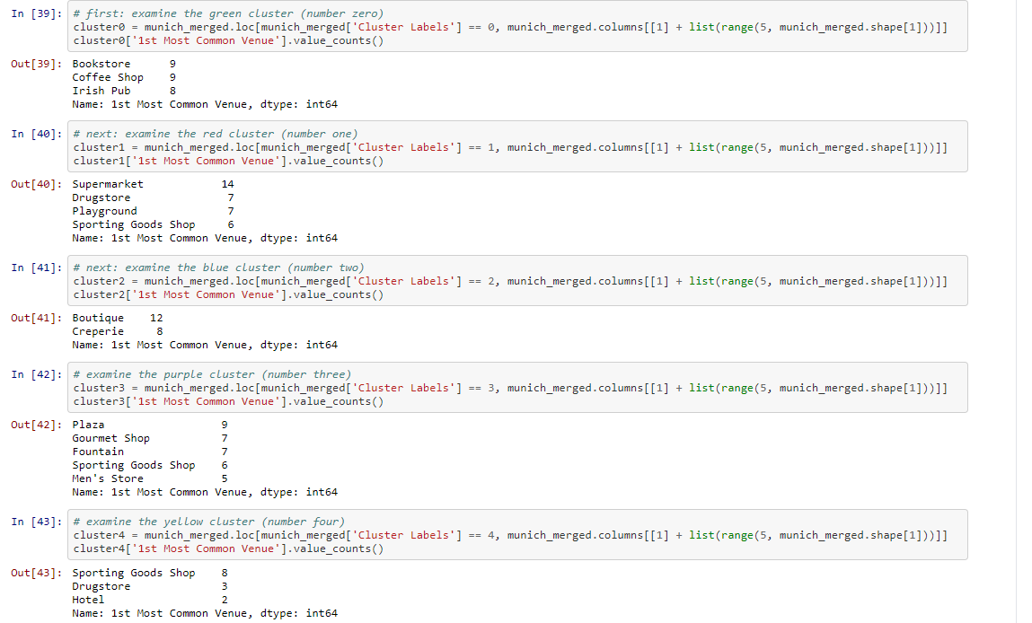
4. Analysis
We perform clustering analysis: We split the districts of Munich into 5 clusters based on the most common venues

Slide 10
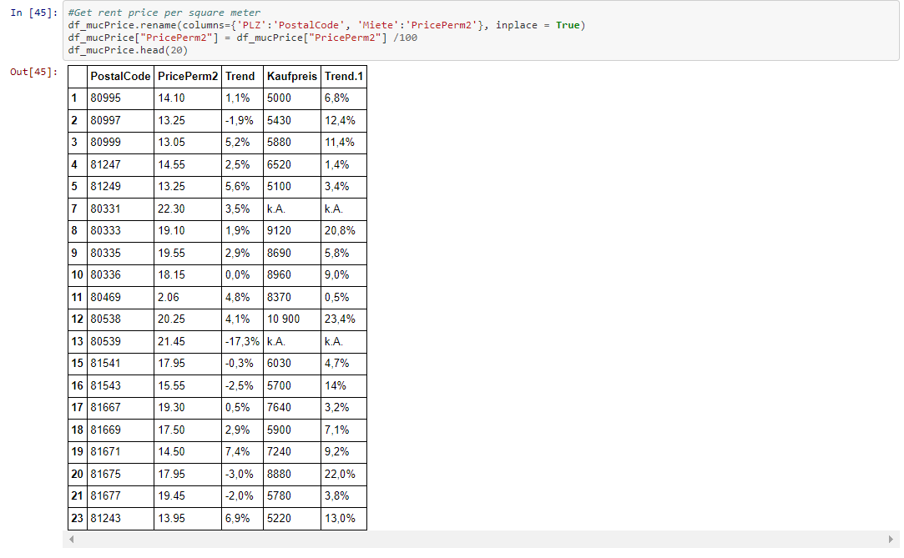
4. Analysis
Munich is a really expensive city in terms of rent prices, so we will perform exploratory analysis for the rent prices per district by utilizing the website:
'https://www.tz.de/leben/wohnen/uebersicht-muenchner-mieten-preise-nach-postleitzahlen-tz-6133643.html'

Slide 11
4. Analysis
Munich is a really expensive city in terms of rent prices, so we will perform exploratory analysis for the rent prices per district by utilizing the website:
'https://www.tz.de/leben/wohnen/uebersicht-muenchner-mieten-preise-nach-postleitzahlen-tz-6133643.html'

Slide 12
5. Results & Discussion
The above analysis demonstrates, that the most suitable districts in Munich for opening a greek restaurant are located in cluster 3, because the frequency of occurence of gourmet shops is high:
Plaza: 9 I Gourmet Shop: 7 I Fountain: 7 I
Sporting Goods Shop: 6 I Men's Store: 5
Such districts are Neu Langwied, Sendling, Obersendling, Pasing, Obermenzing, Perlach, Maxvorstadt and Neuperlach

Slide 13
5. Results & Discussion
Our findings from the rent price exploratory analysis suggest, that the top 5 neighborhoods with the lowest rent price per m2 in the purple cluster are:
Neu Langwied
Allach
Aubing
Pasing
Moosach

Slide 14
6. Conclusion
Based on our analysis and results, we choose Pasing-Obermenzing as the district that will host our new greek restaurant because there already exist 3 greek tavernas and 0 greek restaurants
That means that a lot of Greek people live in this neighborhood and since there is no greek restaurant operating there we will have the monopoly of the business
In terms of price Pasing is not as cheap as Neu Langwied, but also not as pricey as Moosach or Maxvorstadt, therefore it is the most suitable district for our new operations

Slide 15
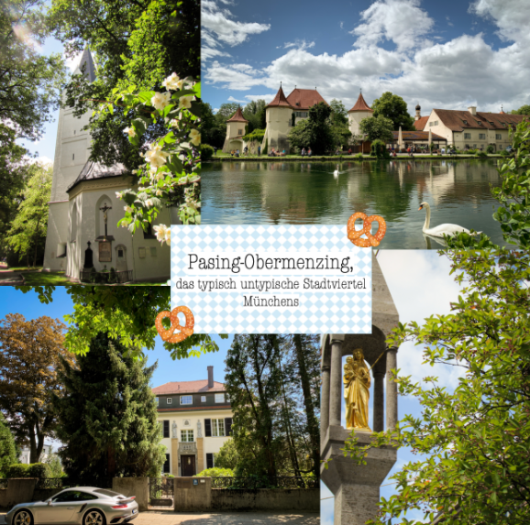
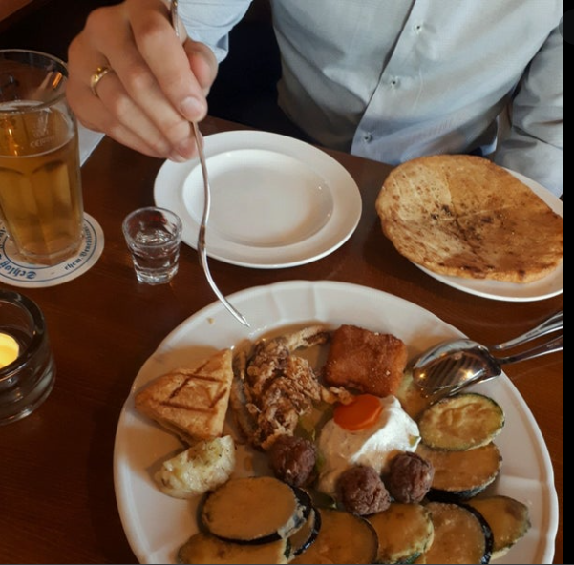
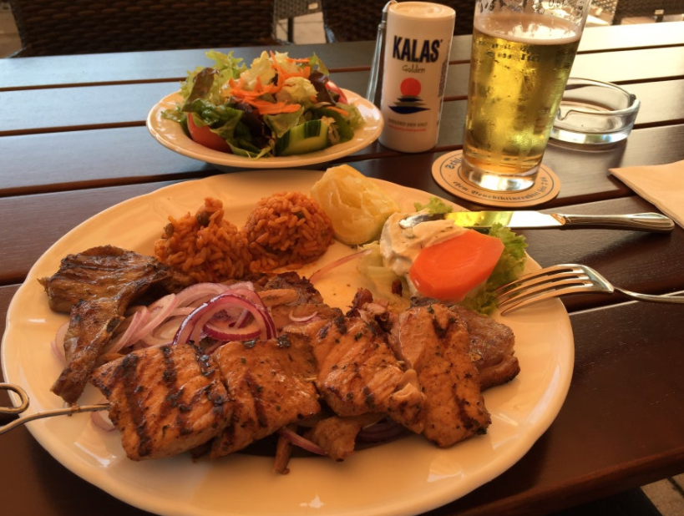
6. Conclusion

